Slide 1
National Honor Society
September - 1st Meeting

Slide 2
Leadership Contact
President: Samuel Courtney samueljc@madisoncity.k12.al.us
Vice President: Diya Patel diyaap@madisoncity.k12.al.us
Sponsors: Mr. Thomas and Ms. Brown

Slide 3
New Officers!
Secretary: Neil Sethi - neils@madisoncity.k12.al.us
Parliamentarian: Landen Waider - landenjw@madisoncity.k12.al.us
Treasurer: Amna Minhas - amnakm@madisoncity.k12.al.us
Historian: Urvi Mysore - urvirm@madisoncity.k12.al.us

Slide 4
New Members
General requirements:
Be a sophomore, junior, or senior
Have a weighted GPA of 3.7 or higher
Complete 20 service hours by April
Complete and submit a new member application by October 12th
Turn in a HARD COPY of the application to Mr. Thomas in A109.
Place your application in a large envelope
Include your updated transcript and new member dues in the envelope
Print your transcript from PowerSchool

Slide 5
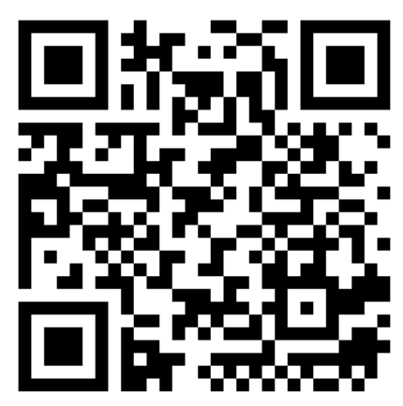
Returning
Members
Sign in today!
https://forms.gle/6NKZsJKA1v2g9xJe6
Complete 20 service hours by April

Slide 6
Membership Requirements
Complete 20 service hours by April
Save all physical copies of completed service hour sheets to turn in by April
Scan and keep duplicate copies of your original service hour sheets to have for proof if the original copies get lost in the submitting process.
Maintain a weighted 3.7 GPA throughout the school year
Attend the mandatory monthly meetings
Attendance taken during every meeting
2 excused absences allowed
(email jlthomas@madisoncity.k12.al.us 24 hours in advance)

Slide 7
Member Dues
New Member Dues
$20
Returning Member Dues
Suspended
Seniors (Optional)
$20 - in addition to club dues, a Senior stole for graduation may be purchased
DEADLINE: Nov. 2nd, 2023; to Mr. Thomas (A109)

Slide 8
Community Service
Must be unpaid volunteer work that helps the community
What DOES NOT count: paid work, tutoring and/or babysitting a family member
Double-dipping allowed for this year
Hours will NOT be accepted without proper documentation!
Keep all original service hour record sheets and their duplicate copies in a safe place until the April deadline.

Slide 9
Service Hours Guidelines:
20 Service hours must be completed by the first week of April
10 hour caps are placed upon the following service activities:
Summer Hours (June-July)
Weekly Religious Events
Donations
You must utilize the Service Hour Form on the JC Website
Hours not documented with supervisor signature will not be counted!

Slide 10
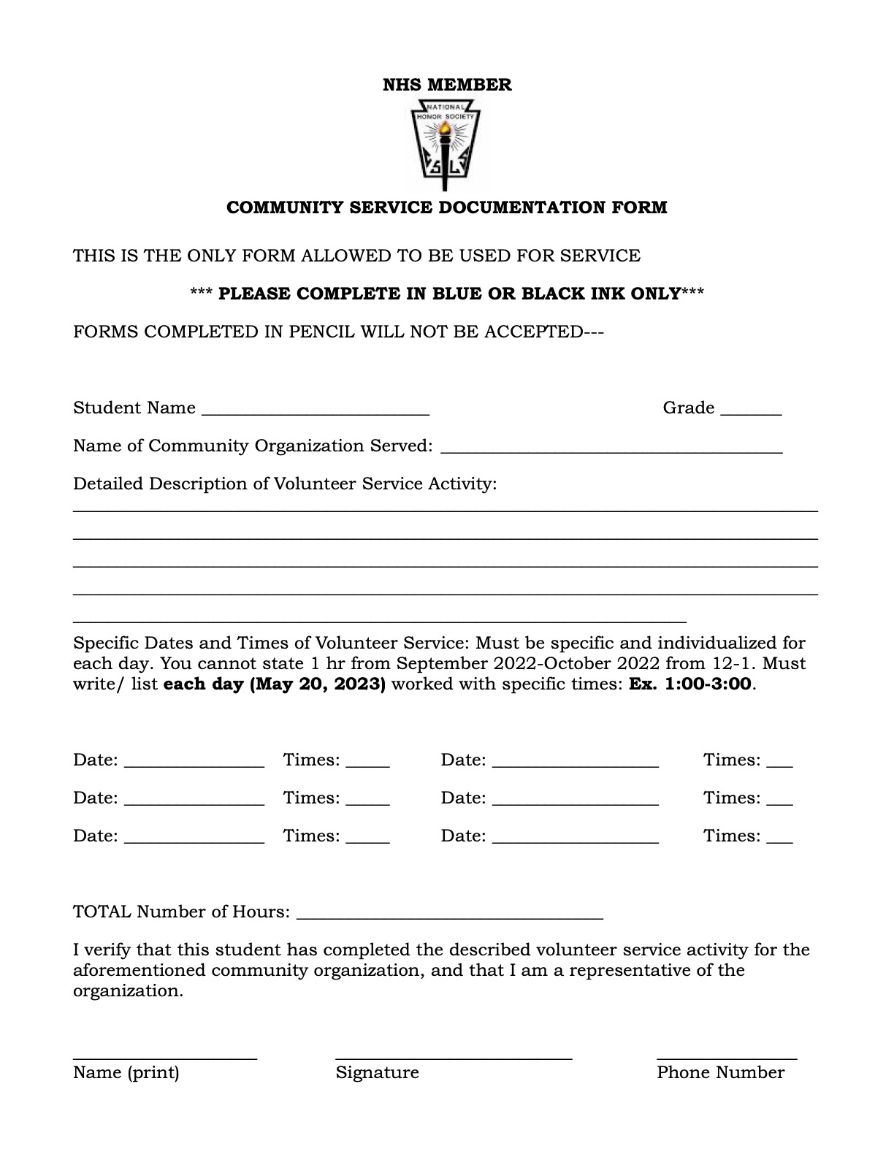
Community Service Form:
Linked on the JC website → Clubs and Organizations → NHS

Slide 11
#1 Madison Witches Ride
Help raise money for a new splash pad park in the city of Madison! Prepare registration packets for participants, work concessions, check witches in, help line up witches for their performance, manage crowds, refill candy, run individual events, paint faces, monitor inflatables, set up, or clean up.
Shift Available: Sunday, October 22, 2023 - shifts available between 10:00 AM - 6:00 PM; Home Place Park, 130 Shorter Street, Madison AL 35758 (directly behind Madison City Stadium)
Sign up to volunteer by October 12th!
https://www.signupgenius.com/go/10C0F4DA4A92CA6FC1-madison1#/

Slide 12
#2 Special Olympics
Tuesday, October 17th (Rain date is Oct. 19th)
Must be in good standing with the school and classes
Must clear with teachers
Milton Frank Stadium
Shifts available from 7:00am to 4:00pm
Sign Up Here: https://www.signupgenius.com/go/10c094aa4ac2fa0f4c43-special#/
Also, email Mr. Thomas if you volunteer.
Volunteers will get an excused absence for their shift - all missed schoolwork must be made-up.

Slide 13
#3 Manna House Food Distribution Center
Assist with food preparation and distribution, clothing distribution, etc. for the less fortunate on Mondays, Wednesdays, and Thursdays from 1:00pm-6:30pm.
Help set up and serve at outdoor church events for the less fortunate on Saturdays from 11:00am-1:00pm.
More information can be found at: https://mymannahouse.com/get-involved/

Slide 14
#4 Rose of Sharon Soup Kitchen
Help prepare and serve food while restocking supplies for the homeless! If you like to make things clean and spotless, you are in luck because Rose of Sharon is also in dire need of volunteers to help clean tables and other surfaces after meals.
PLEASE CALL THEM FIRST BEFORE SIGN UP!
Sign Up Link + Available Volunteer Times: https://www.signupgenius.com/go/10c0f44a8ac28a6fbc25-rose

Slide 15
#5 Free 2 Teach
Job #1: “Assist with Teacher Shopping” - help teachers with their shopping, check them in and out, restock school supplies and other goods for teachers.
Tuesdays & Thursdays 2:45pm-6:00pm
1st Saturday of every month during the school year 9:00am-12:00pm
Sign Up Link + More Information: https://free2teach.org/impact/volunteer/

Slide 16
#6 Trash Panda Fall Festival
Activities including Trick-or-Treating will take place between 5pm-7pm At the Toyota Field
Volunteers will be needed … ?
Link for signup: https://docs.google.com/forms/d/e/1FAIpQLSdr-9hu8EcYmnzcwkMxvl65DgIM8w9u6a14pS9x0lO8WuO1BA/viewform?usp=sf_link

Slide 17
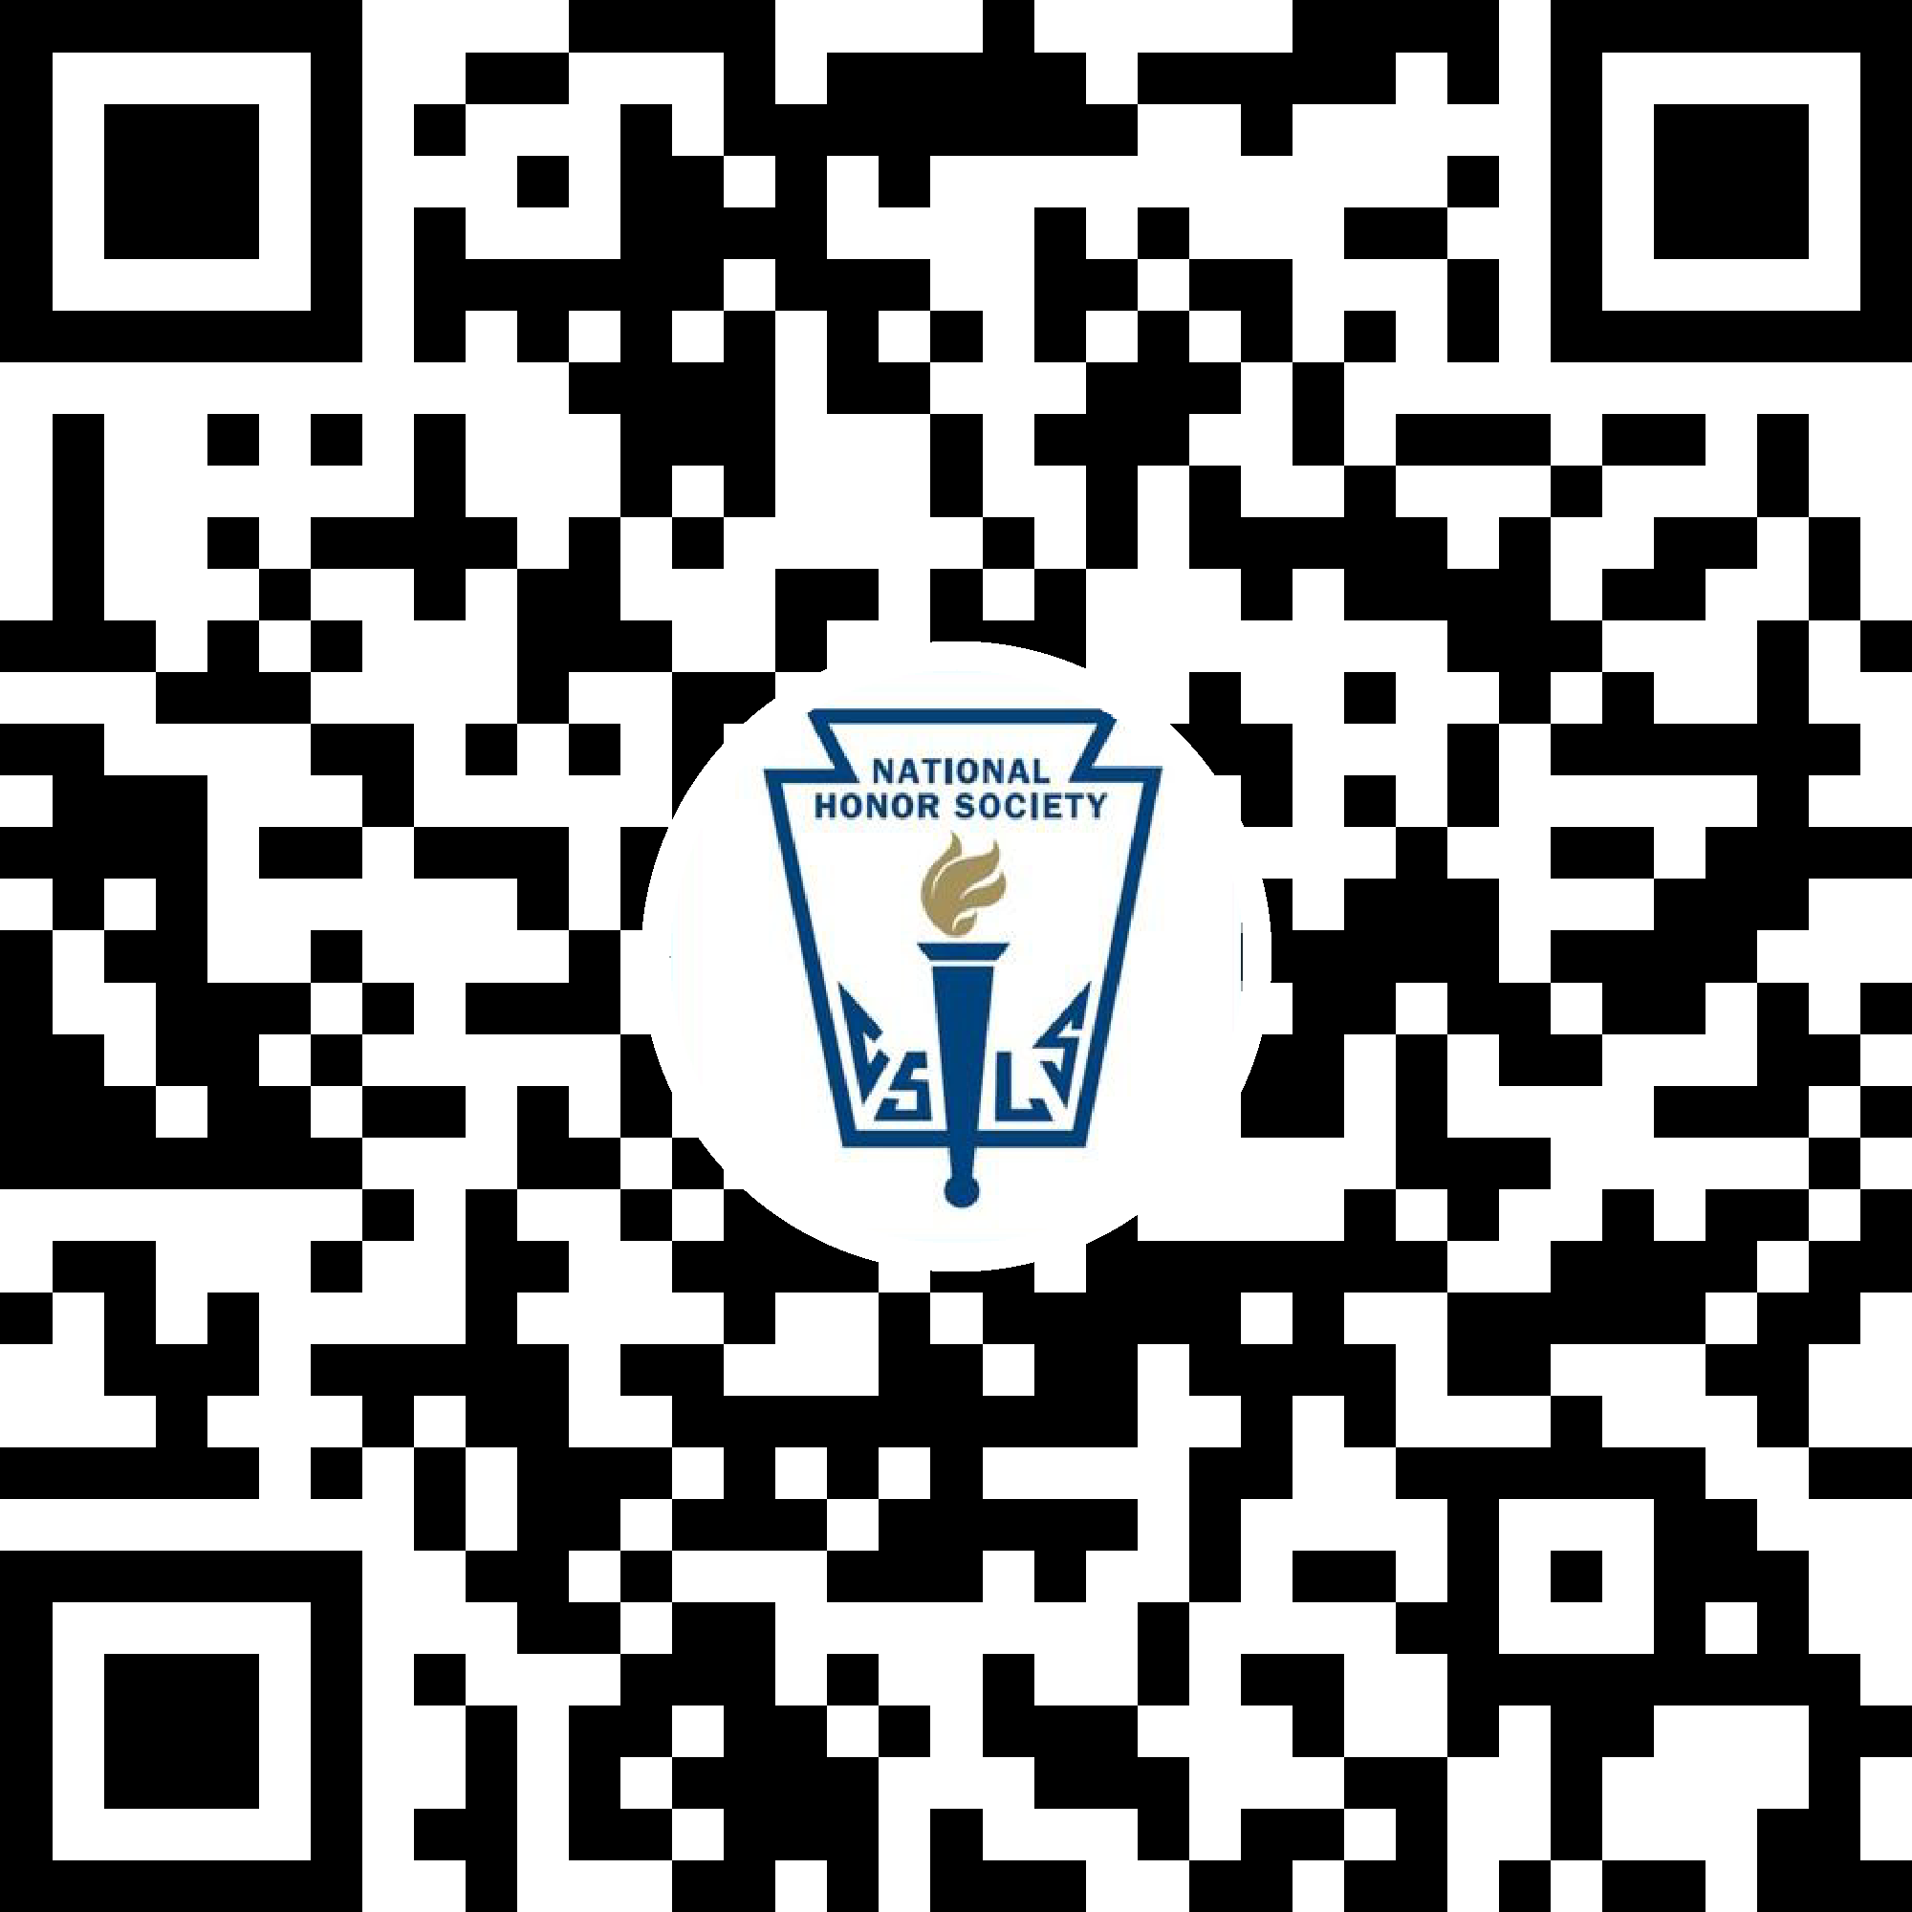
Join The Attendance & GroupMe
Announcements & Updates:
Attendance: GroupMe:

